Slide 1
Practical Applications
Budget friendly meal plan

Slide 2
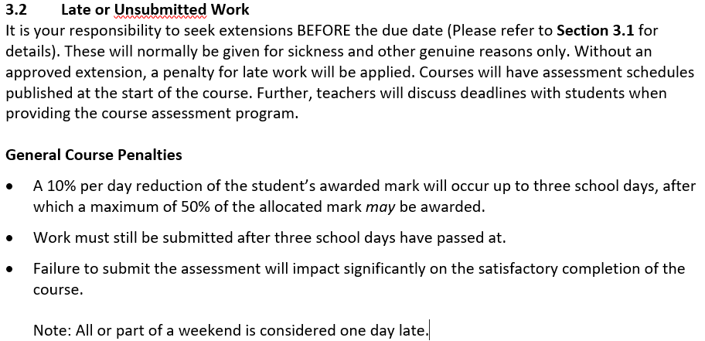
Assessment policy
Notes:
Make sure you are clear about how lateness will affect their grades.

Slide 3
Mathematical Thinking Process

Slide 4
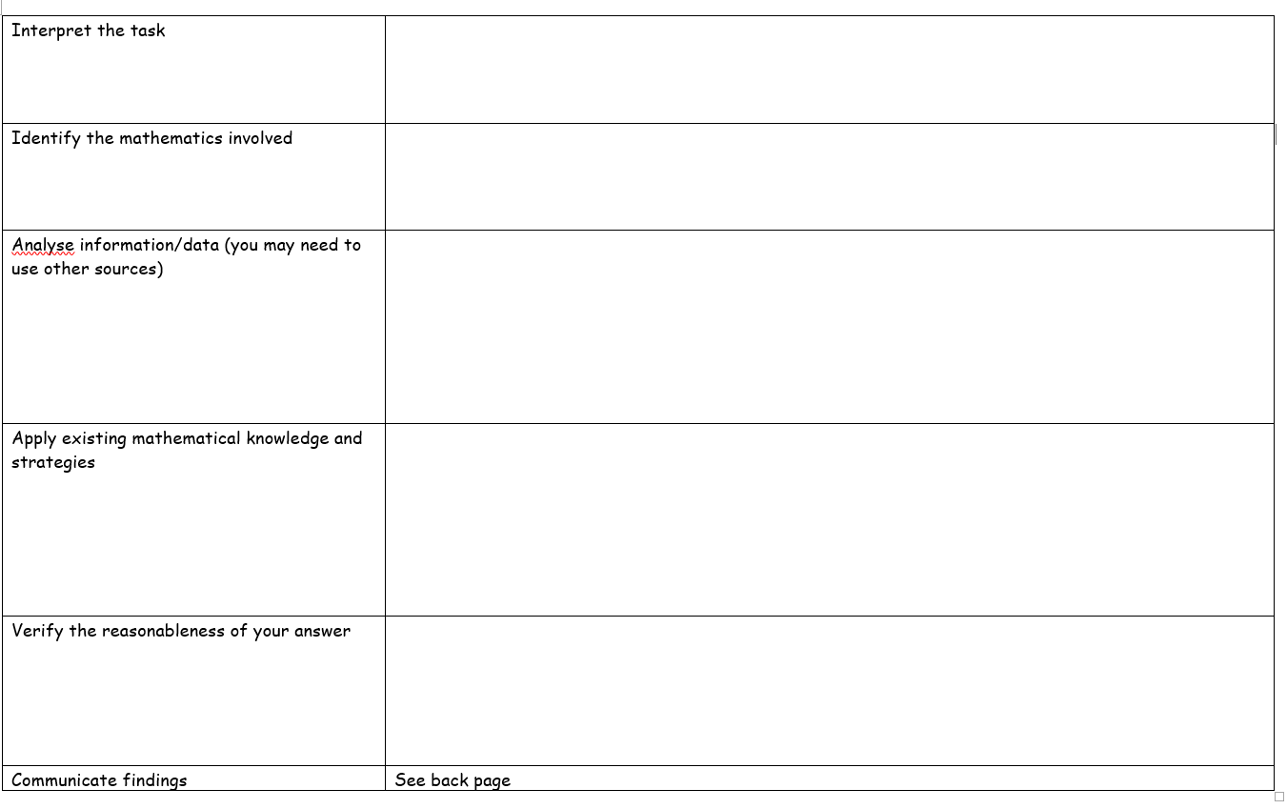
Planning sheet
Notes:
Hand out planning sheet to students

Slide 5
Task: Budget friendly meal plan
Plan 3 meals, with left overs, for a total of 6 dinners, for a few different scenarios. Combine recipes to make a class recipe book organised into weekly meals.
Task is in text book on page 9
Notes:
Hand out task sheet

Slide 6
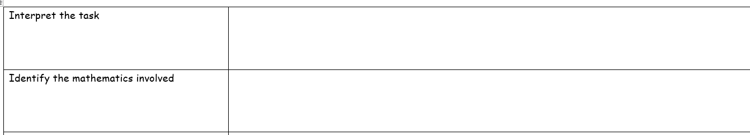
Mathematical thinking process Planning
Notes:
Go through the planning stages with the class this needs to be completed to move on to the computer lesson. What are you being asked to do?
What information do you need to find out? What information do you already know? Make a list of the information you need to find out
What mathematics will be required to complete the task?

Slide 7
Computer lesson
Task for today.
Find information that you need to find.
Put it into a spread sheet on Microsoft excel

Slide 8
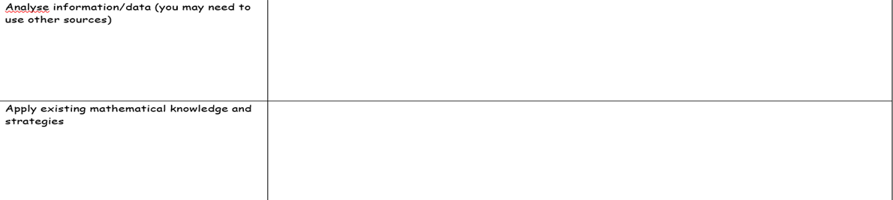
Notes:
Use the internet to find the information required and fill in the analyse box
The Applying existing knowledge is when we start using excel.

Slide 9

Slide 1
Using a Spreadsheet
Lesson 1

Slide 10
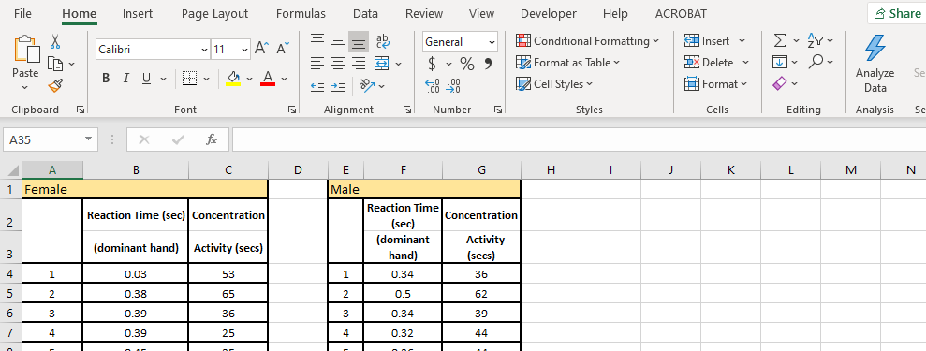
Slide 2
What is a spreadsheet?
A spreadsheet is a digital file made of rows and columns that help sort, organize, and arrange data efficiently, and calculate numerical data.
There are many versions of spreadsheets.
Microsoft Excel.
Apple Numbers.
Google Sheets.
Quip.
EtherCalc.
Zoho Sheets.
LibreOffice.
Apache OpenOffice Calc
We are just going to concentrate on using Microsoft office, but all spreadsheets are similar and use similar commands.
To start with we are going to look at some terminology.

Slide 11
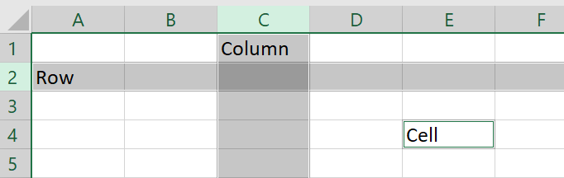
Slide 3
A spreadsheet page is organised into a grid made up of lots of rectangles called “cells”
These cells are organised horizontally into rows and vertically into columns
In the picture above, the “C” column and row “2” are both highlighted.
When we name a cell, we always mention the column, then the row., So we can say that the word “Cell” was written in cell “E4”.

Slide 12
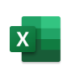
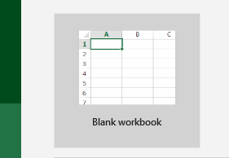
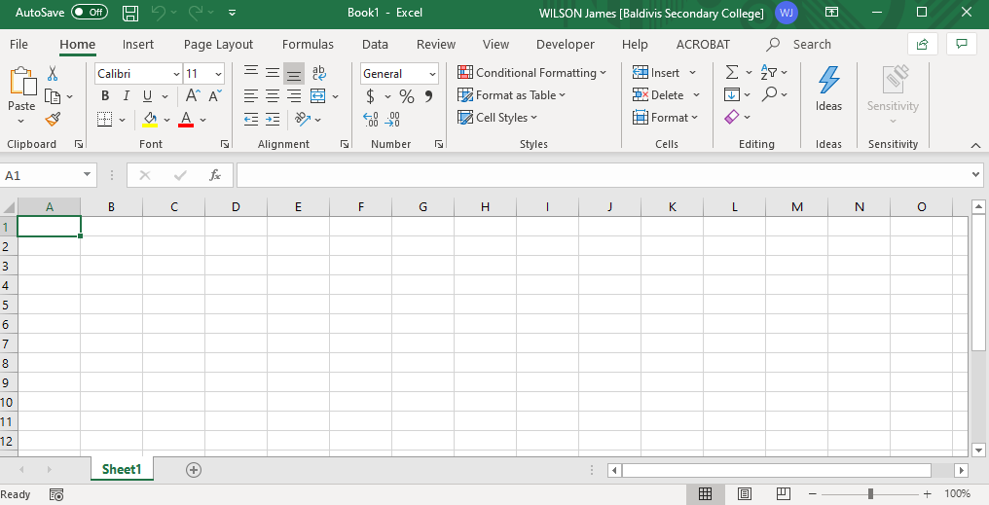
Slide 4
Open Excel – it’s time to try it together
Open excel – click on the “Excel” logo. It should be somewhere in your Windows menu or you can type “Excel” into your Search toolba,. Once Excel loads, double click onto “blank workbook”
You should now have a blank spreadsheet
4

Slide 13
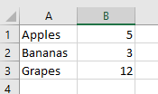
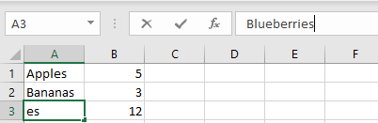
Let’s insert some data
Click on cell “A1 and type “Apples” then press enter. It should take you down to cell A2. Type “Bananas” and press enter. Then type “Grapes” and press enter again. Now click on cell B1 and type 5, press enter, type 3, press enter and type 12. Your table should look like this:
If you make a mistake, click on the cell that has the mistake and type the changes into the formula bar. Try using the formula bar to change Grapes to Blueberries so that the spreadsheet now looks like this:

Slide 14
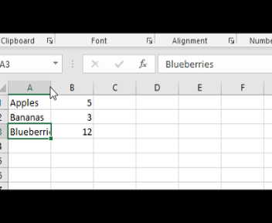
Resize the column
You will notice that the word Blueberries doesn’t fit into the column correctly. You can resize the column by grabbing the line between column A and B and dragging the column to the size that you want. (you can do the same with rows).

Slide 15
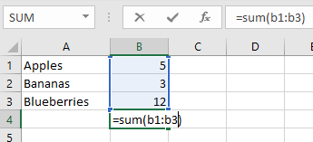
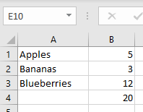
Now we are going to add a formula.
Formulas can be used to do calculations for us.
Click on the cell “b4”and enter the following
=sum(b1:b3)
This will add all the values in cells in the region starting from cell b1 and continuing to cell b3
Now change the number of bananas to 7 and the number of apples to 9, you will see that the spreadsheet immediately recalculates the total for you.

Slide 16
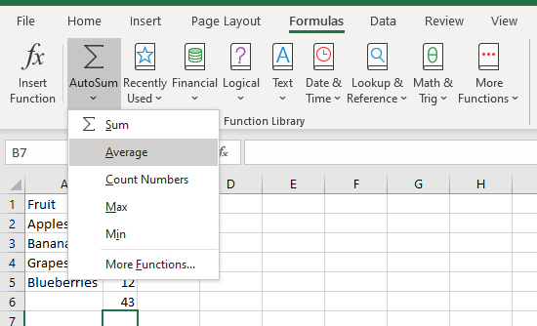
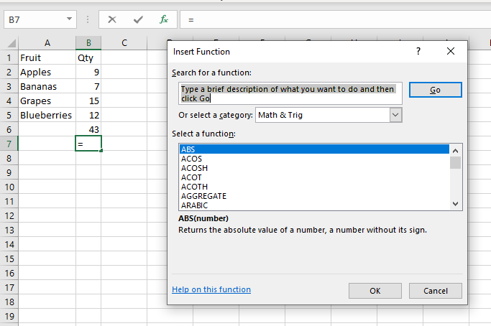
Other formulas
There are many formulas in excel that you can use.
To find them all, click on a cell and go to the Formula’s tab. Here they are grouped into categories.
You can also click the fx button on the formula bar and get a list of all the formulas.

Slide 17
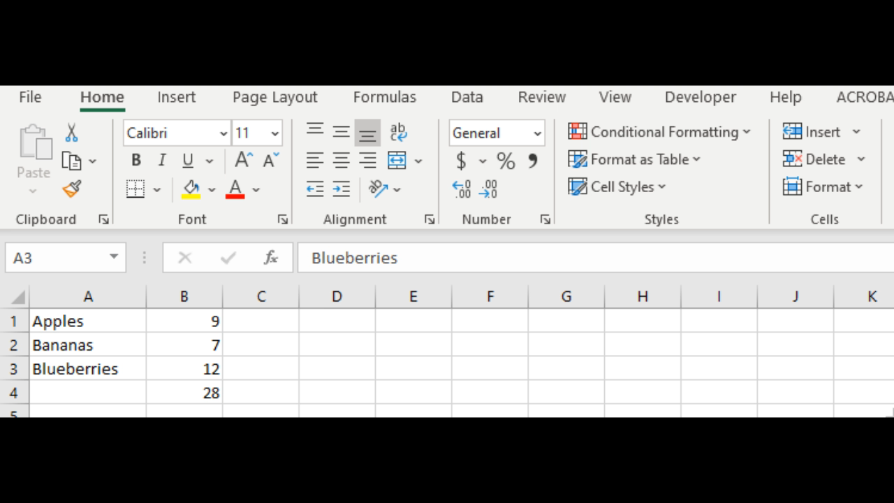
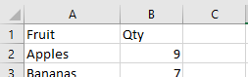
Add an extra row of fruit into our table
I am going to add Grapes back into the table just above the Blueberries. Click on row number 3 which highlights the entire row. Then click on the “insert cells” icon on the “Home” section of the ribbon and add a new row. Now type in “Grapes” in the new cell add 15 as the quantity.
You can also add and remove columns using the same process.
Notice that formula we added before automatically recalculates the new total with the new row included.
Use this method to add a row above your table so you can add headings to your column such as “Fruit” and “Quantity”

Slide 18
Communicating findings.
Report:
Introduction:
Restate the question in your own words (What is the task you are doing)
State how you are going to complete the task
Information you need
Mathematics involved
Body:
Show how you completed the task
Explain why and how you completed the task
Use diagrams, graphs, tables or calculations (explain why/how it relates to the task
Conclusion:
Restate question
Give solution to task
State any limitations/how could you could improve the results of the task

